Slide 1

Cypriot Banks: Navigating
Global Challenges and Future Prospects
Andreas Milidonis
Professor of Finance
Department of Accounting & Finance
Faculty of Economics & Management
University of Cyprus
June 27, 2023

Slide 2
Outline: Cypriot Banks
Global Challenges
  Pandemic and Russia
  Anti-Money Laundering (AML)
  ESG
European Challenges
  Transparency
  Regulation
  Asset Quality (NPLs) + Capital Adequacy
  ECB Monetary Policy
  Digitization

Slide 3
1.1 Pandemic/Russian Invasion
Economic consequences of managing the pandemic.
The Russian invasion of Ukraine.
Banking “incidents” in the US and Europe
  Silicon Valley Bank (SVB)
  Signature Bank
  First Republic Bank
  Credit Suisse

Slide 4


1.2 Anti Money Laundering
Significant progress made since 2013.
But more work to be done.
Moneyval (2019)
https://rm.coe.int/anti-money-laundering-and-counter-terrorist-financing-measures-cyprus-/16809c3c47

Slide 5
1.2 Anti Money Laundering
Moneyval (2019), p.108:
“Overall, this ML/TF risk mitigation activity appears to represent a conscious, strenuous effort by Cyprus banks to clearly improve their compliance with the established regulatory framework, and the public perception of such compliance. While still a work in progress and not uniformly successful, overall this effort has had remarkable results.
Examination results tend to confirm that banks are taking more, and more effective ML/TF risk mitigation steps than they did in the 2013-2016 examination cycle.”

Slide 6

1.2 Anti-Money Laundering
US and UK Sanctions (April 2023): served as a good test for Cypriot banks.
We witnessed:
Good reflexes by Cypriot Banks at the announcement of recent sanctions.
Freezing of accounts of sanctioned individuals and any corporations connected to them.

Slide 7
1.3 ESG
Environmental, Social and Governance (ESG) is happening!
Like many other regime changes happening around the world, they arrive in Cyprus with a delay.
Cypriot Banks are among the leaders in Cyprus, in adopting ESG standards and practices.

Slide 8

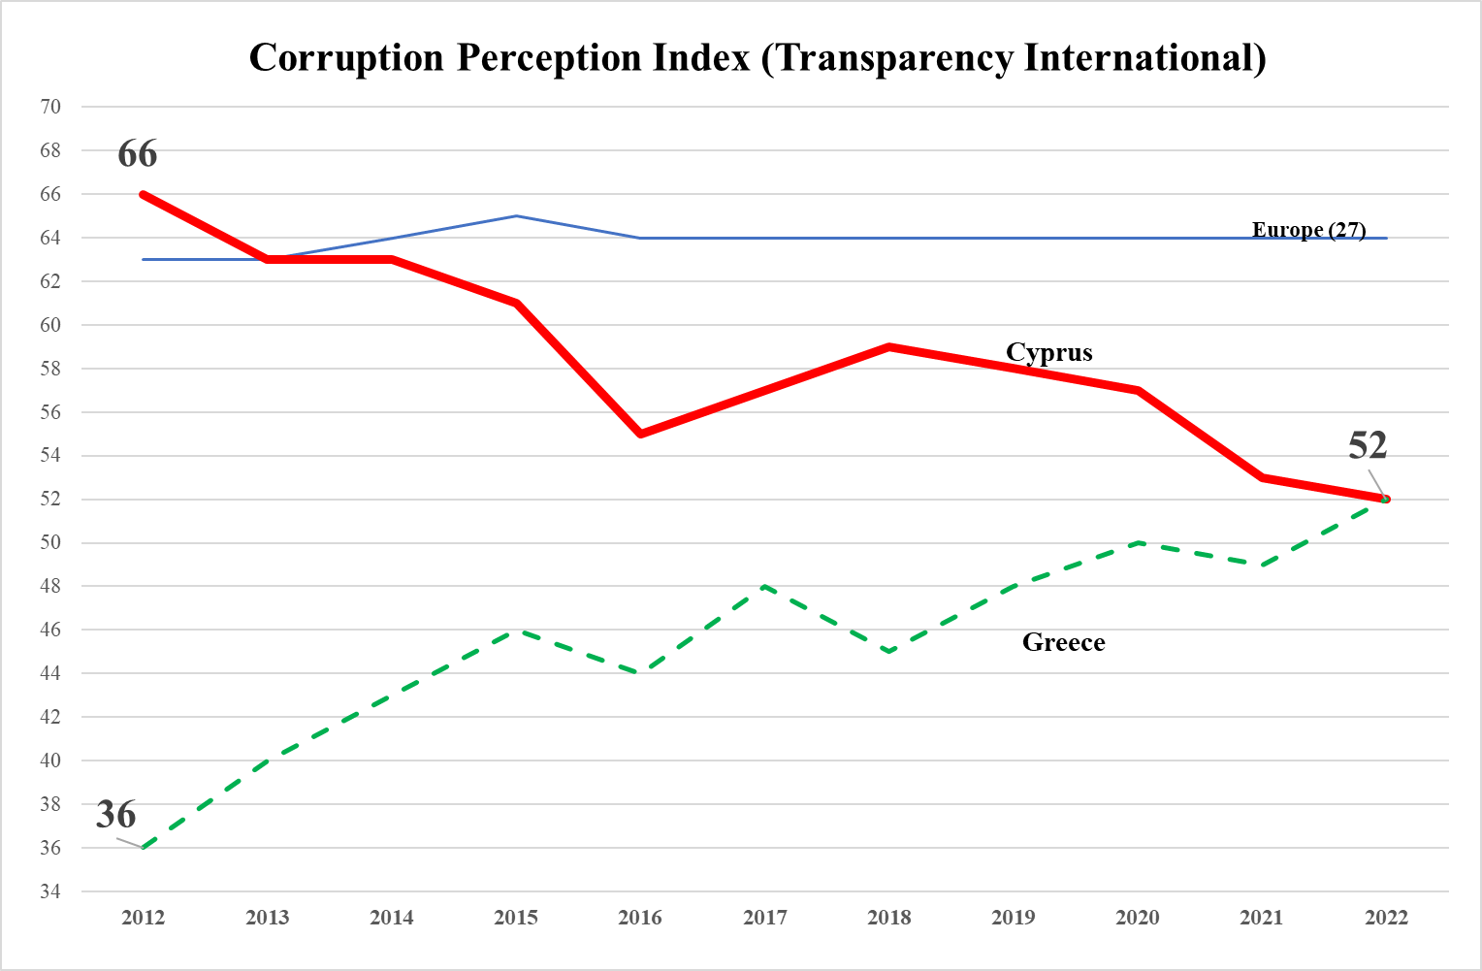
2.1 Transparency in Cyprus
  Higher score => higher transparency (lower corruption perception)
  Cyprus perceived to be more opaque than average, which likely makes it harder for the operations of Cypriot banks.
Notes:
Banks operate in a more opaque environment than others

Slide 9
2.2 Regulation
European Banking Union forthcoming.
Regulation for European Banks is becoming more uniform.
Country Differences: not only size but culture as well.
National Culture affects bank risk & bank deposits.
This has implication for Regulation.

Slide 10
2.2 Research on:
Bank Risk or Deposits
Individualism
Trust
Hierarchy

Slide 11
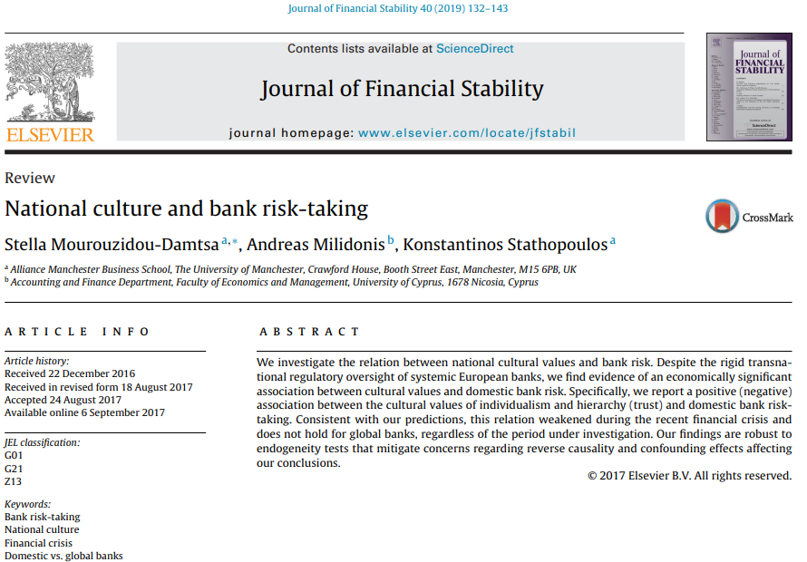
2.2 National Culture and Bank Risk

Slide 12
2.2 National Culture (Europe)

Slide 13

2.2 Trust
Survey which poses the following Question:
“Generally speaking, would you say that most people can be trusted or that you need to be very careful in dealing with people?”
Higher values indicate higher trust in people.

Slide 14
2.2 Trust
Impact on Risk or Deposits
Within Europe, as we move from a country of
  Low to High TRUST => Bank Risk
  => Deposits
References:
  National Culture and Bank risk-taking: Link
  National Culture and Bank deposits: Link

Slide 15
Research Results important to:
Bank Regulators:
  When designing horizontal risk benchmarks across Europe.
  Not all banks are the same and national culture matters.
  In addition to size, Cyprus is different with respect to Trust.
Bank Boards: when designing compensation risk-taking incentives for their CEOs.
Bank Managers: when deciding on liquidity, also considering how potential depositors will behave with respect to their deposits.

Slide 16
2.3 Banking Sector Consolidation
Major structural changes after 2013 due to European Regulation, AML, sanctions (etc.).
Examples:
  Cyprus Popular Bank Public Co Ltd 2013
  FBME Bank Ltd 2014
  Cyprus Cooperative Bank 2018
  RCB Bank Ltd 2022

Slide 17
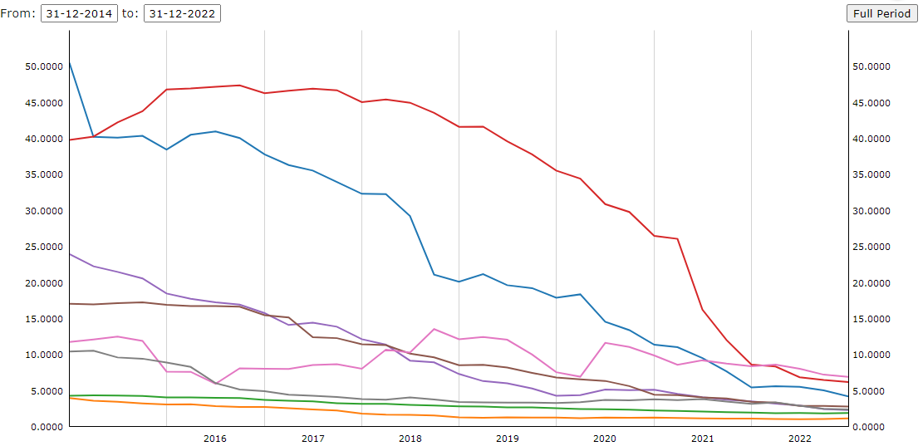

2.3 Bank Asset (Loan) Quality
Non-Performing Loans: Significant progress.
More work to be done for the Cyprus Banking Sector.
Source: ECB (SDW) Consolidated Banking data. Link
Notes:
https://sdw.ecb.europa.eu/browseChart.do?org.apache.struts.taglib.html.TOKEN=e92a32812adb9333cd840461c4133b56&df=true&ec=1&dc=&oc=0&pb=1&rc=0&DATASET=0&removeItem=&removedItemList=&mergeFilter=&activeTab=CBD2&showHide=&REF_AREA.266=CY&REF_AREA.266=DE&REF_AREA.266=FR&REF_AREA.266=GR&REF_AREA.266=IE&REF_AREA.266=IT&REF_AREA.266=LV&REF_AREA.266=MT&MAX_DOWNLOAD_SERIES=500&SERIES_MAX_NUM=50&node=SEARCHRESULTS&q=CBD2.Q.%3F.W0.11._Z._Z.A.F.I3632._Z._Z._Z._Z._Z._Z.PC&type=series
CBD reference sector breakdown: Domestic banking groups and stand-alone banks
Consolidated banking data item: Gross non-performing loans and advances [% of total gross loans and advances]

Slide 18

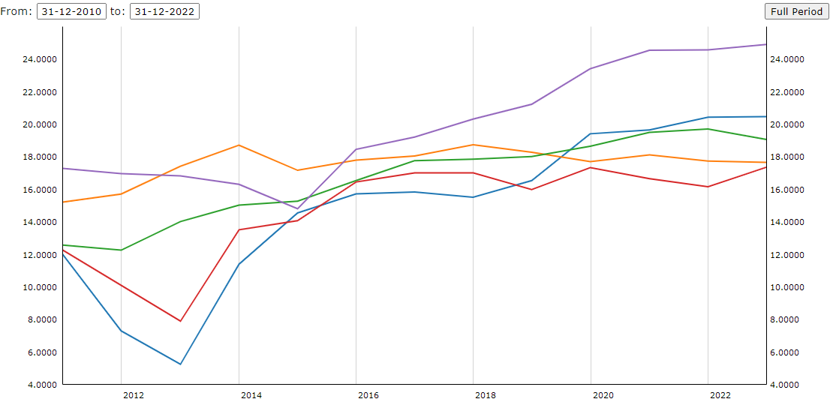
2.3 Solvency ratio [%]
Good Job for the Cyprus Banking Sector.
Source: ECB (SDW) Consolidated Banking data. Link
Notes:
Dataset name: Consolidated Banking data
Frequency: Annual
CBD reference sector breakdown: Domestic banking groups and stand-alone banks
Consolidated banking data item: Solvency ratio [%]
Unit of measure:Percent
https://sdw.ecb.europa.eu/browseChart.do?org.apache.struts.taglib.html.TOKEN=d2b845f387db271c65c576930984b926&df=true&ec=1&dc=&oc=0&pb=1&rc=0&DATASET=266&removeItem=&removedItemList=&mergeFilter=&activeTab=CBD&showHide=&FREQ.266=A&REF_AREA.266=CY&REF_AREA.266=DE&REF_AREA.266=FR&REF_AREA.266=GR&REF_AREA.266=MT&CB_REP_SECTOR.266=11&CB_ITEM.266=I4001&MAX_DOWNLOAD_SERIES=500&SERIES_MAX_NUM=50&node=SEARCHRESULTS&q=solvency%20ratio&type=series

Slide 19

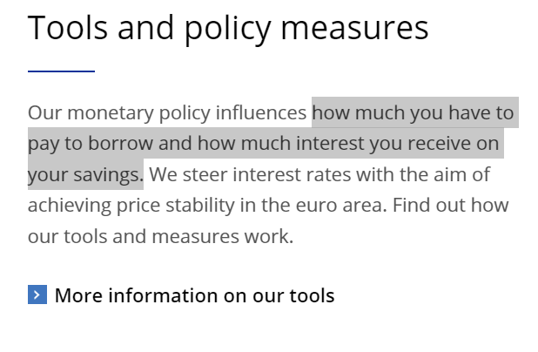
2.4 ECB Monetary Policy

Slide 20
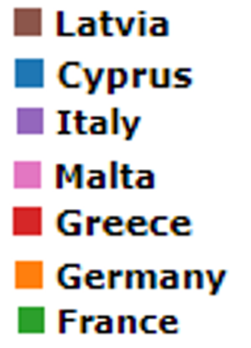
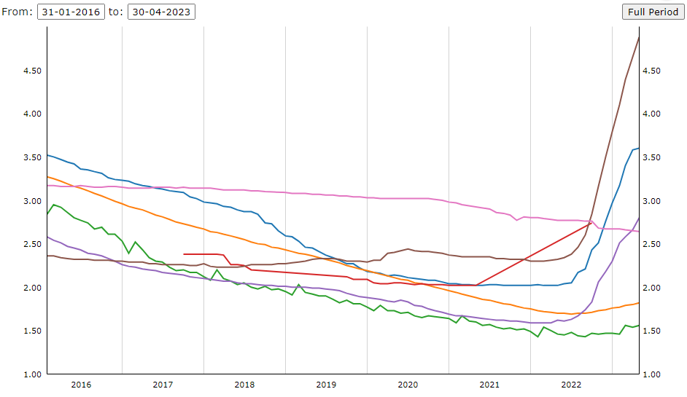
2.4 Loan Interest Rates
Outstanding Amounts (House Purchase)
Similar or faster response to ECB rate hikes than others…
Source: ECB (SDW) MFI Interest Rate Statistics. Link
Notes:
Period is from 2016 until END of APRIL 2023
Focus on the BLUE line
Cypriot banks increase their interest rates on loans in a similar fashion to other EU banks, that are comparable to Cyprus on
Size (Malta, Latvia)
Culture (Greece)
For comparison I also include the big countries in Europe
Germany
France
Italy
THESE ARE AMOUNTS OUTSTANDING. Same applies for NEW BUSINESS (next slide)
MFI Interest Rate Statistics
Monthly
Deposit taking corporations (except CB)
Lending for house purchase
Annualised agreed rate (AAR) / Narrowly defined effective rate (NDER)
Amount category: Total
BS counterpart sector: Households and non-profit institutions serving households (S.14 and S.15)
Currency of transaction: Euro
IR business coverage: Outstanding amount
https://sdw.ecb.europa.eu/browseChart.do?org.apache.struts.taglib.html.TOKEN=e9e677d99536199a675e8d1a2dc5675b&df=true&ec=&dc=&oc=&pb=&rc=&DATASET=3&removeItem=&removedItemList=&mergeFilter=&activeTab=MIR&showHide=&REF_AREA.36=CY&REF_AREA.36=DE&REF_AREA.36=FR&REF_AREA.36=GR&REF_AREA.36=IT&REF_AREA.36=LV&REF_AREA.36=MT&BS_ITEM.36=A22&MATURITY_NOT_IRATE.36=A&MAX_DOWNLOAD_SERIES=500&SERIES_MAX_NUM=50&node=9691393

Slide 21
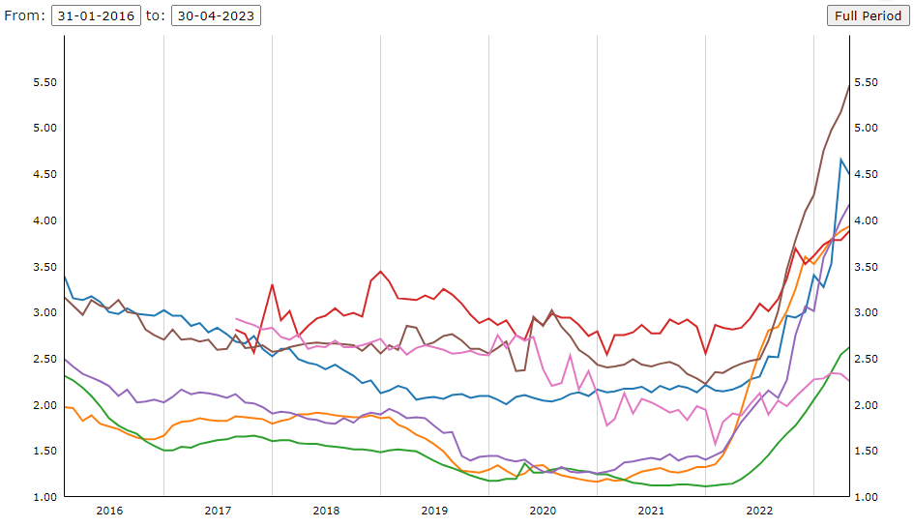
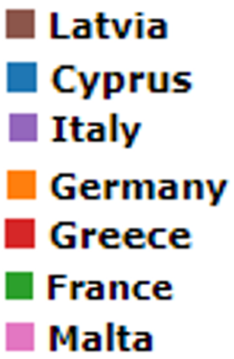
2.4 Loan Interest Rates
New Business (House Purchase)
Similar or faster response to ECB rate hikes than others…
Source
Notes:
MFI Interest Rate Statistics
Monthly data
Deposit taking corporations (except CB)
Lending for house purchase excluding revolving loans and overdrafts, convenience and extended credit card debt
Annualised agreed rate (AAR) / Narrowly defined effective rate (NDER)
Amount category: Total
BS counterpart sector: Households and non-profit institutions serving households (S.14 and S.15)
Currency of transaction: Euro
IR business coverage: New business
https://sdw.ecb.europa.eu/browseChart.do?org.apache.struts.taglib.html.TOKEN=dc8ac25c9c5ca18dec41e95e951b8e85&df=true&ec=&dc=&oc=&pb=&rc=&DATASET=0&removeItem=&removedItemList=&mergeFilter=&activeTab=MIR&showHide=&REF_AREA.36=CY&REF_AREA.36=DE&REF_AREA.36=FR&REF_AREA.36=GR&REF_AREA.36=IT&REF_AREA.36=LV&REF_AREA.36=MT&BS_ITEM.36=A2C&MATURITY_NOT_IRATE.36=A&MAX_DOWNLOAD_SERIES=500&SERIES_MAX_NUM=50&node=9691393

Slide 22
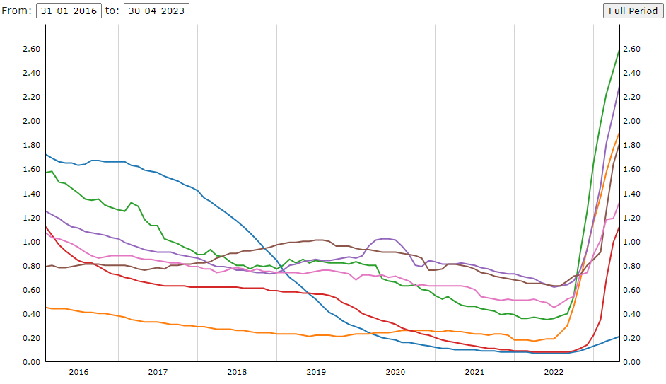
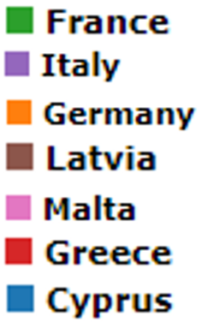
2.4 Deposit Rates
Outstanding Amounts (2 years)
Slower response to ECB rate hikes than others…
Source
Notes:
But what about deposit rates? Different picture.
Deposit rates in Cyprus appear sticky.
You are looking at outstanding amounts
Same for New Business. (NEXT SLIDE)
Monthly data
Deposit taking corporations (except CB)
Deposits w agreed maturity up to 2 years
Annualised agreed rate (AAR) / Narrowly defined effective rate (NDER)
Amount category: Total
BS counterpart sector: Households and non-profit institutions serving households (S.14 and S.15)
Currency of transaction: Euro
IR business coverage: Outstanding amount
https://sdw.ecb.europa.eu/browseChart.do?org.apache.struts.taglib.html.TOKEN=f79b7c1dee6ebf49e58feb6f0d72fb3a&df=true&ec=&dc=&oc=&pb=&rc=&DATASET=1&removeItem=&removedItemList=&mergeFilter=&activeTab=MIR&showHide=&REF_AREA.36=CY&REF_AREA.36=DE&REF_AREA.36=FR&REF_AREA.36=GR&REF_AREA.36=IT&REF_AREA.36=LV&REF_AREA.36=MT&MATURITY_NOT_IRATE.36=L&BS_COUNT_SECTOR.36=2250&CURRENCY_TRANS.36=EUR&MAX_DOWNLOAD_SERIES=500&SERIES_MAX_NUM=50&node=9691394&legendPub=published

Slide 23
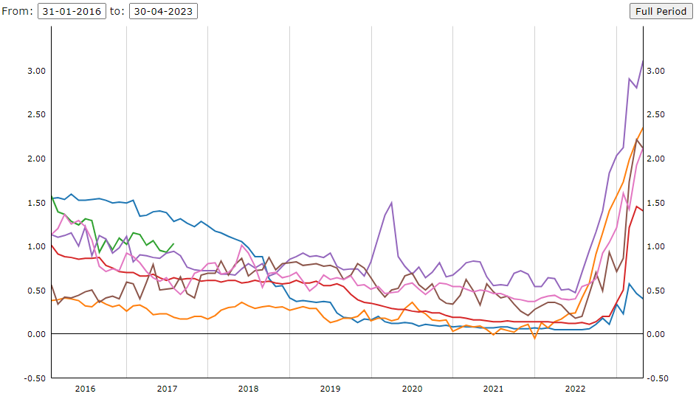
2.4 Deposit Rates
New Business (2 years)
Slower response to ECB rate hikes than others…
Source
Notes:
Monthly data
Deposit taking corporations (except CB)
Deposits w agreed maturity up to 2 years
Annualised agreed rate (AAR) / Narrowly defined effective rate (NDER)
Amount category: Total
BS counterpart sector: Households and non-profit institutions serving households (S.14 and S.15)
Currency of transaction: Euro
IR business coverage: New Business
https://sdw.ecb.europa.eu/browseChart.do?org.apache.struts.taglib.html.TOKEN=f79b7c1dee6ebf49e58feb6f0d72fb3a&df=true&ec=&dc=&oc=&pb=&rc=&DATASET=1&removeItem=&removedItemList=&mergeFilter=&activeTab=MIR&showHide=&REF_AREA.36=CY&REF_AREA.36=DE&REF_AREA.36=FR&REF_AREA.36=GR&REF_AREA.36=IT&REF_AREA.36=LV&REF_AREA.36=MT&MATURITY_NOT_IRATE.36=L&BS_COUNT_SECTOR.36=2250&CURRENCY_TRANS.36=EUR&MAX_DOWNLOAD_SERIES=500&SERIES_MAX_NUM=50&node=9691394&legendPub=published

Slide 24
2.4 Interest Rates - Summary
Relative to recent interest rate increases by the ECB:
Deposit rates:
We observe a rather “sticky” trend in Cyprus relative to other Eurozone (EZ) countries.
Same trend for both outstanding amount and also new business.
Deposit rates among the lowest in EZ.
Loan rates:
We observe a rather “responsive” trend in Cyprus.
Trend is comparable to many other Eurozone (EZ) countries.
Loan Rates among the highest in Europe.
Same trend for both outstanding amount and also new business.

Slide 25
2.4 Why the deviations?
Why do we observe these deviations in interest rates in Cyprus vs. other EU countries?
Possible explanations:
Increased market concentration (low competition)?
Excess Liquidity?
Are Cypriots more risk averse than others?
Is it the low level of Trust self-reported by Cypriots?
Any other reason?
Notes:
https://www.ecb.europa.eu/pub/pdf/scpwps/ecb.wp2270~9c72a27c18.en.pdf

Slide 26

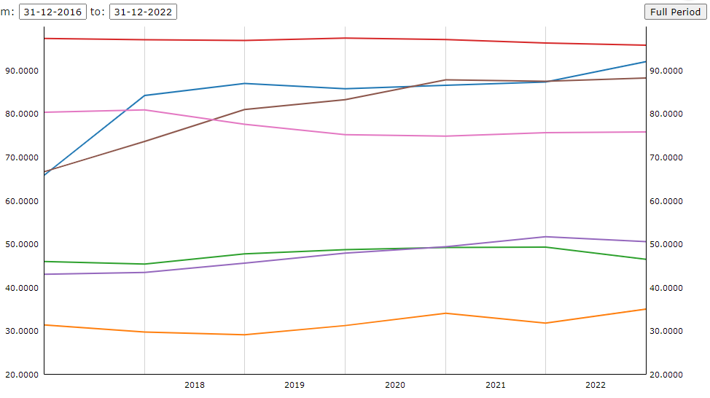
Market Concentration?
Share of largest 5 Credit Institutions: 2nd most concentrated.
Source: Banking structural statistical indicators (2022). Link
Notes:
Focus on the BLUE
Second most concentrated banking sector in Europe.
Share of the 5 largest CIs in total assets (CR5)
Annual
Credit Institutions
https://sdw.ecb.europa.eu/browseSelection.do?type=series&q=SSI.A.%3f.122C.S10.X.A1.Z0Z.Z&node=SEARCHRESULTS

Slide 27


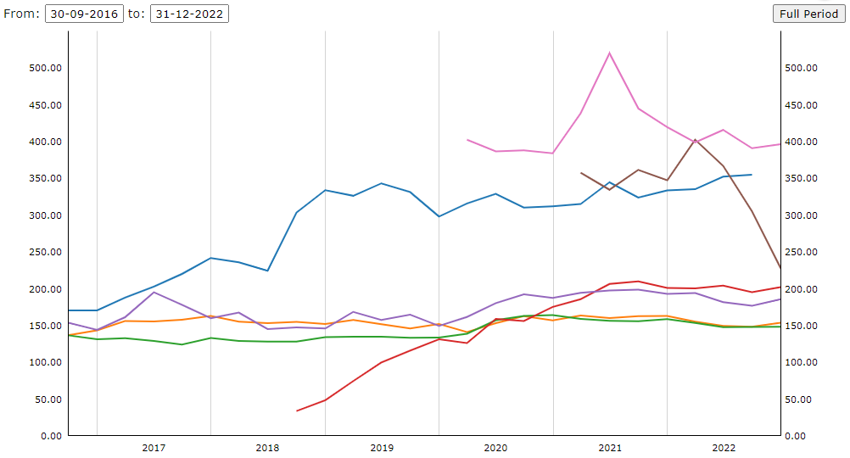
Is it Liquidity?
Liquidity Coverage Ratio: 2nd highest in Europe.
Source: Supervisory Banking Statistics (2022). Source
Notes:
Liquidity coverage ratio at 310% as at December 2022, according to Governor of Central Bank.
https://www.stockwatch.com.cy/el/article/trapezes/k-irodotoy-paramenoyn-oi-prokliseis-trapezon?utm_source=dlvr.it&utm_medium=twitter
Supervisory Banking Statistics
Quarterly
Counterpart area: World (all entities, including reference area, including IO)
Consolidated banking data item: Liquidity Coverage Ratio
Total
Significant institutions
Percentage
Supervisory banking statistics sample type: Changing sample
https://sdw.ecb.europa.eu/browseChart.do?org.apache.struts.taglib.html.TOKEN=019d9833d5fa5b3a7e57752ec6f3dfde&df=true&ec=1&dc=&oc=0&pb=1&rc=0&DATASET=305&removeItem=&removedItemList=&mergeFilter=&activeTab=CBD2&showHide=&REF_AREA.305=CY&REF_AREA.305=DE&REF_AREA.305=FR&REF_AREA.305=GR&REF_AREA.305=IT&REF_AREA.305=LV&REF_AREA.305=MT&COUNT_AREA.305=W0&SBS_DI_1.305=SII&MAX_DOWNLOAD_SERIES=500&SERIES_MAX_NUM=50&node=SEARCHRESULTS&q=Liquidity%20coverage%20ratio&type=series

Slide 28


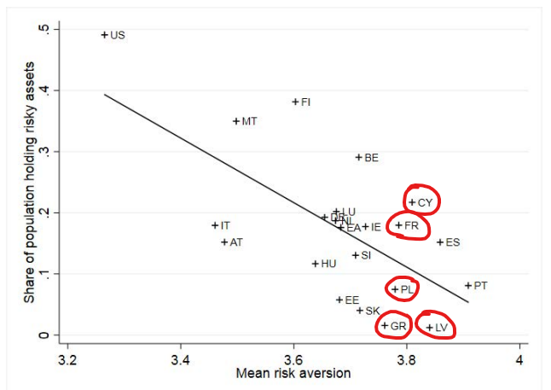
Are Cypriots more risk averse?
Risk Aversion vs. Share of population holding risky assets.
Cypriots not very different from GR, LT.
Figure 4 from Bekhtiar, Fessler and Lindner (2019)
Notes:
https://www.ecb.europa.eu/pub/pdf/scpwps/ecb.wp2270~9c72a27c18.en.pdf
Similar risk aversion to other countries (GR, FR, LV) that have
Higher deposit rates and
Lower loan rates
And we seem to invest more in risky assets than other countries with similar Risk aversion

Slide 29
Is it Trust?

Slide 30



2.5 Digitization
We observe significant efforts from banks to adopt digitization.
Bank fees should be used as a way to motivate digitization.
But we still observe:
  Annual Fees on basic debit cards
  Annual Fees on basic bank accounts.
  Annual Fees for “account maintenance”
  Increases in the above fees over time.
How are the above encouraging digitization?

Slide 31

2.5 Digitization
At the same time, how can digitization proceed without significant improvement in financial literacy through financial education?
Suggestion:
  Why not allocate some bank employees to train customers a few days per year?
  This could happen at schools, universities, and/or other public events scheduled for retired people, unemployed people and others who might want to learn e-banking.

Slide 32
Conclusions
Cypriot Banks operate in an environment with:
The lowest Trust level self-reported across Europe
The 3rd lowest Transparency score as perceived by non-Cypriot, experts on Transparency
At least 4 major bank “closures” in the past decade.
Yet, they have improved significantly on:
Corporate governance
Asset Quality
Capital Adequacy
Anti-Money Laundering and Compliance

Slide 33
Conclusions
Challenges ahead:
Interest Rates
Liquidity Management
Optimizing Asset and Liability Management
Digitization & Financial Education
ESG

Slide 34

Thank you
Contact: Andreas Milidonis
Email: Andreas.Milidonis@ucy.ac.cy
Phone number: +357 22 89 3626
Web: http://amilidonis.com/
Twitter: @A_Milidonis

